Slide 1
MPI Closeness Centrality
By Samuel Chih, Phillip Dang, Michael Melkonian and Abdul Muhammad
Notes:
Sam: 2,3
Abdul: 6
Michael: 4,5
Phillip: 7

Slide 2
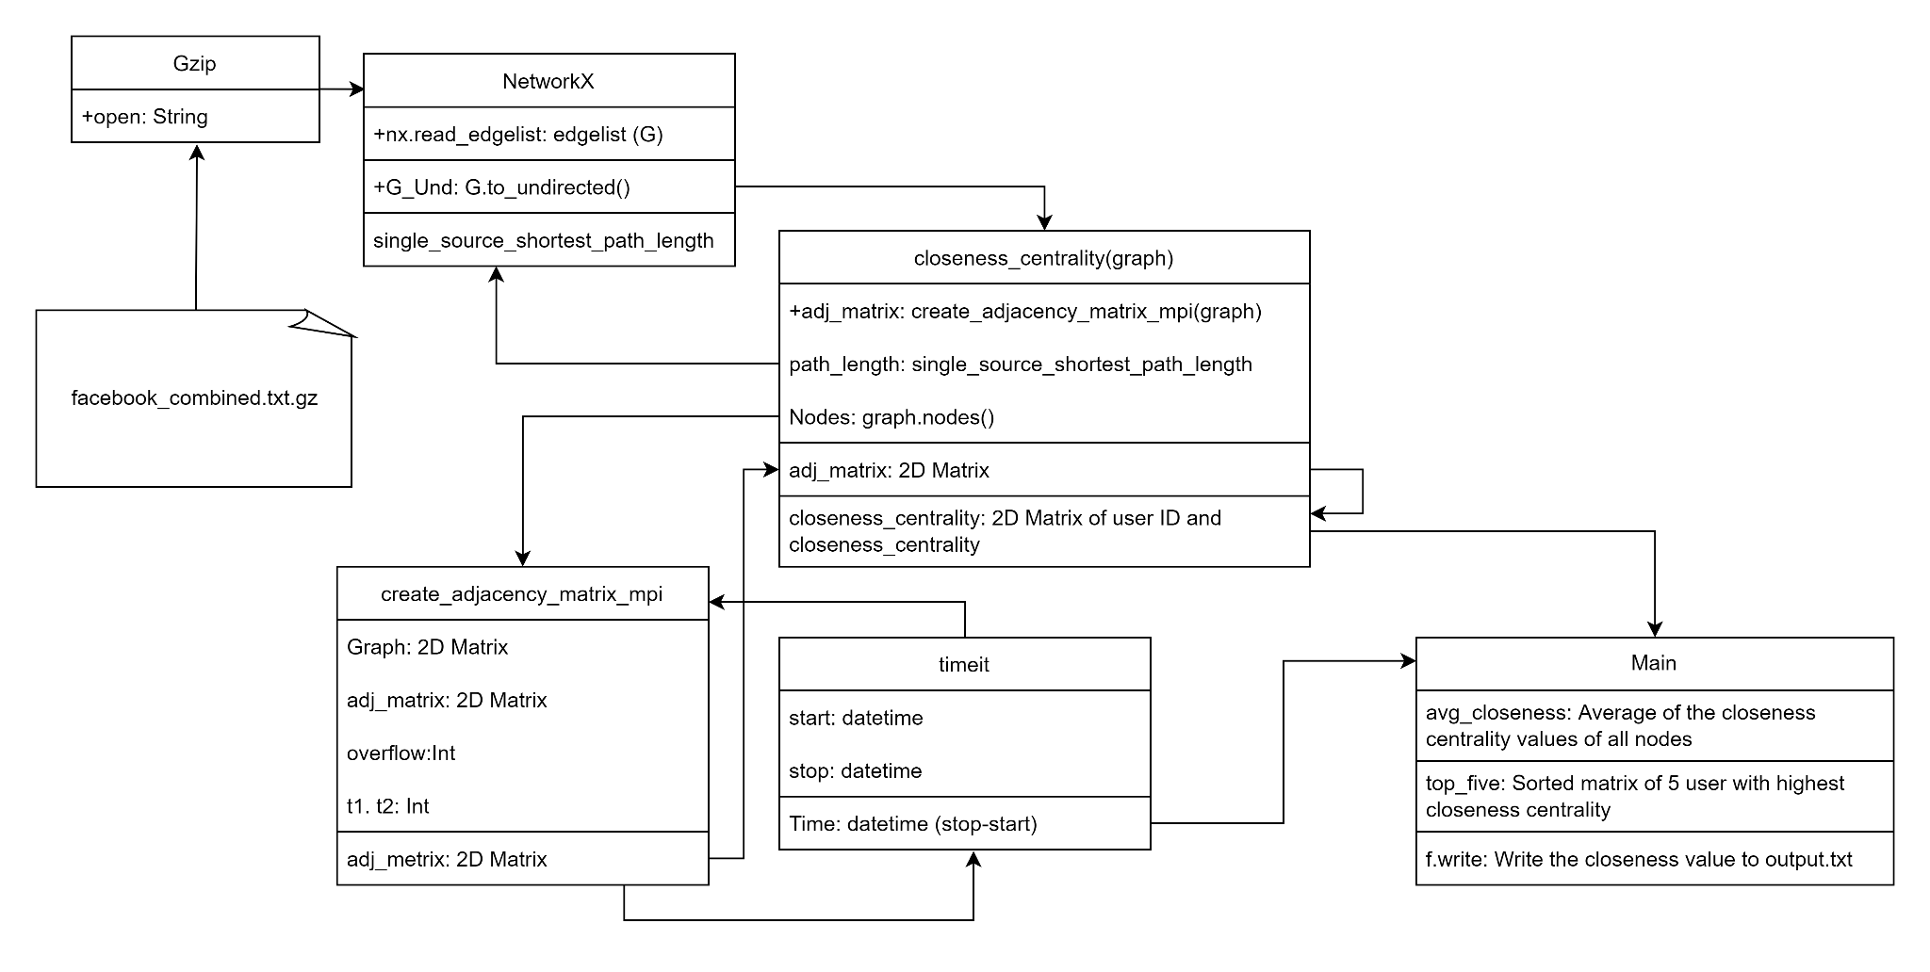
UML diagram

Slide 3
Code design
Use Floyd-Warshall to create adjacency matrix
#######################
Floyds Algo Pseudo
Floyds All Pairs Shortest
procedure FWSP(A)
begin
D^(0) = A
for k = 1 to n do:
for i = 1 to n do: # <= Broadcast kth row to all processors using MPI
for j = 1 to n do:
d(k)_i,j = min(d(k-1)_i,j,d(k-1)i,k+d(k-1)_k,j)
end FWSP
#######################

Slide 4
Code design
Implement MPI to Floyd-Warshall
def create_adjacency_matrix_mpi(graph):
n = len(graph)
matrix_slice = 0
excess = 0
# Rank 0 sends slices of the adjacency matrix to all other processes
if rank == 0:
finish = 0
result = []
comm.bcast(n, root = 0) # Broadcast the number of nodes
excess = n % (size - 1)
matrix_slice = (n - excess) / (size - 1)
# Send slices
for i in range(1, size):
comm.send(graph, i, finish)
while (True):
comm.recv(result, 3, MPI.ANY_SOURCE, MPI.ANY_TAG, status)
if status.Get_tag() == finish:
finish += 1
else:
if graph[(result[1] * n) + result[2]] > result[0]:
graph[(result[1] * n) + result[2]] = result[0]
if finish >= size - 1:
break

Slide 5
Code design
# Set up message to send
msg = []
comm.recv(n, 1, 0, status)
comm.recv(graph, n * n, 0, status)
if rank + 1 != size:
excess = 0
for k in range(matrix_slice * (rank - 1), matrix_slice * (rank - 1) + matrix_slice + excess):
for i in range(len(n)):
for j in range(len(n)):
if graph[(i * n) + k] * graph[(k * n) + j] != 0 and i != j:
graph[(i * n) + j] = graph[(i * n) + k] + graph[(k * n) + j]
msg[0].append(graph[(i * n) + j])
msg[1].append(i)
msg[2].append(j)
comm.send(msg, 3, 0)
#print(graph)
return graph

Slide 6
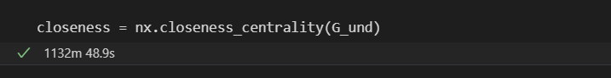

Analysis
Takes 18 hours and 52 minutes to get Twitter’s closeness centrality result using NetworkX, without MPI
49.4 second for Facebook data set
Using MPI
4 core Time: 23.132 sec

Slide 7
Time and space complexity
Time complexity O(n³)
Space complexity O(n²)
n is the number of vertices (|V|) in Graph

Slide 8
Challenges we faced
Due to technical difficulty we do not have time and resources to try out Multicore CPU v. GPU performance
We do see there are exponential time improvement between single and multicore
Some margin of error shows between our result and NetworkX.
We got Floyd-Warshall Algorithm work in single core, but having difficulty when convert MPI implement Floyd-Warshall Algorithm to closeness centrality
Closeness centrality difficulty in producing optimal results, although values were not completely as expected, it seems that the implementation of our algorithm had a decent structure that yield an error in our findings

Slide 9
Tasks performed by each team member
Samuel Chih - Presentation slide, UML diagram, adj_matrix to closeness centrality, five nodes with the top centrality values, and average of the centrality values of all node.
Phillip Dang - Research implementations of the Floyd-Warshall algorithm for closeness centrality, format code, add/edit comments, proofread slides]
Abdul Muhammad - Implement Floyd-Warshall in MPI
Michael Melkonian - Designed Floyd-Warshall algorithm, configuring the dictionary version of graph to function with the FW-MPI algorithm, worked on bringing functionality to the closeness_centrality function

